Slide 1
Introduction to Electromagnetism with Practice Orientation for Practice
2016/09/07

Slide 2
Introduction
Prof.
Professor : Sung Jae Kim
Room : 301-905
Homepage : http://ees.snu.ac.kr
(Energy Environment Sustainability Laboratory)
TA.
Room: 301- 914
Dokeun Lee leedk0315@nate.com
Sungho Baek yooybaek@gmail.com
Junsuk Kim kallajoker@snu.ac.kr
Sangjun Lee supersize@snu.ac.kr

Slide 3
Introduction
Time
PM 6:30 ~8:30 Wednesday
Place
301-207
Notice board
http://etl.snu.ac.kr

Slide 4
Schedule
1st phase | 2rd week (9/5~9/9) | 09 / 07 | OT | Orientation
 | 3th week (9/12~9/16) | 09 / 14 |  | 추석
 | 4th week (9/19~9/23) | 09 / 21 | Ex.1 | Introduction for using Matlab
2nd phase | 5th week (9/26~9/30) | 09 / 28 | Ex.2 | Introduction to Numerical Methods
 | 6th week (10/3~10/7) | 10 / 5 |  | 휴강
 | 7th week (10/10~10/14) | 10 / 12 | Ex.3 | Finite Difference Method (1D differential eq.)
 | 8th week (10/17~10/21) | 10 / 19 | Ex.4 | Finite Difference Method (2D Laplace eq.)
3rd phase | 9th week (10/24~10/28) | 10 / 26 |  | 중간고사
 | 10th week (10/31~11/4) | 11 / 2 |  | 중간 고사 휴식
 | 11th week (11/7~11/11) | 11 / 9 | Ex.5 | Separation of Variable Method (2D Laplace eq.)
 | 12th week (11/14~11/18) | 11 / 16 | Ex.6 | Finite Element Method, Electric field (FEMM software)
4th phase | 13th week (11/21~11/25) | 11 / 23 |  | 휴강
 | 14th week (11/28~12/2) | 11 / 30 | Ex.7 | Finite Element Method, Magnetic field (FEMM software)

Slide 5
Evaluation
전체 성적 = 이론(75%) + 실험(25%)
실험 성적 평가기준
퀴즈 : 실험시작 전 10분(6시40분까지), 수업 ppt 내용
결과 보고서 : 퀴즈와 함께 하드카피로 제출, 이전 실험 과제
실습 과정
결과 보고서 제출 메일: electromagnetism301@gmail.com
Copy , Delay penalty
Copy : 해당 실험 0점 (교수님께 보고)
Delay : 하루에 ½씩 점수 차감(10점 → 5점 → 2.5점 → 1점 → 0점)
지각 : 퀴즈 이후 도착한 경우, 지각2회 = 결석1회
결석 : 무단 결석 2회(=지각 4회) 이상이면 전체 실험 점수 0점 처리
* 사정상 참여할 수 없다면 조교와 미리 상담할 것

Slide 6
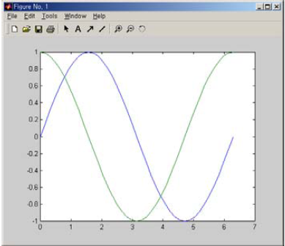
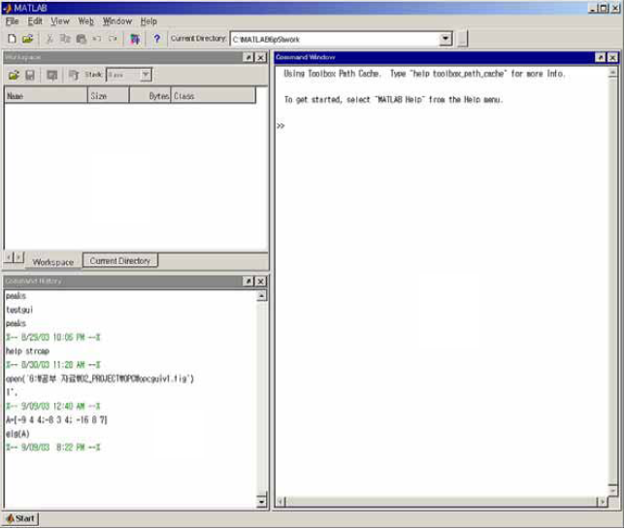
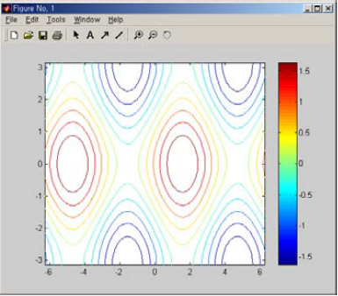
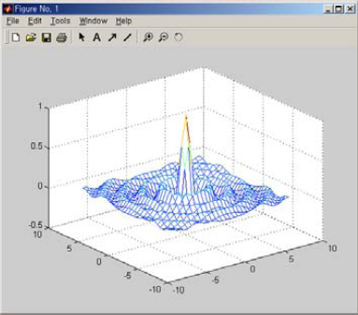
#1. Matlab (MATrix LABoratory)
Visualization of result by Numerical Analysis & Calculation

Slide 7

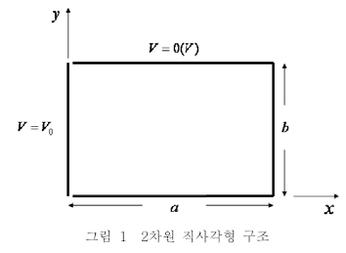
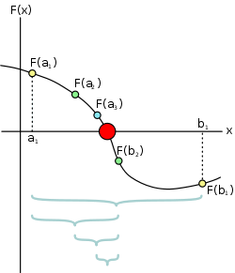


#2. Numerical Methods (Bisection, Newton–Raphson Method)
VS
Examples)
Bisection
Newton–Raphson

Slide 8


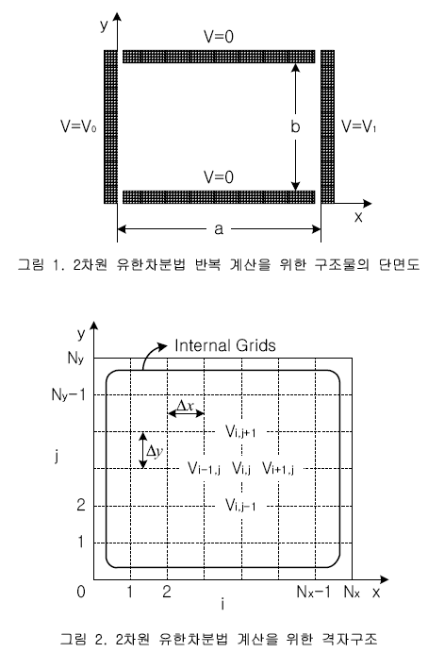


#3,#4 Solve ODE by FDM (Finite Difference Method)
1st Derivative
Finite Difference Equation

Slide 9


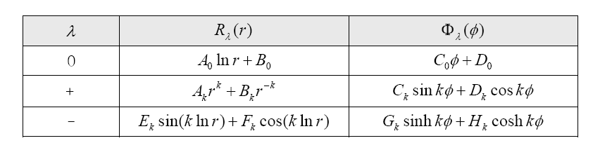

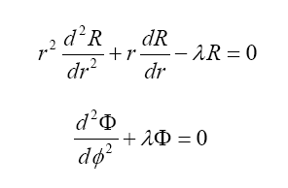

#5. Solve ODE by SVM (Separation of Variables Method)

Slide 10
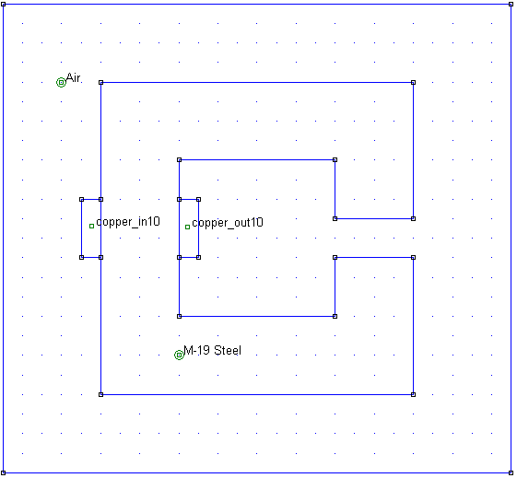
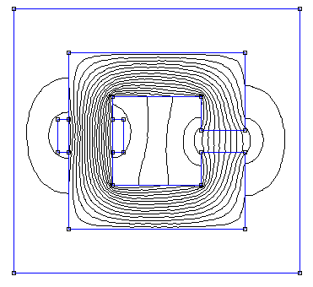
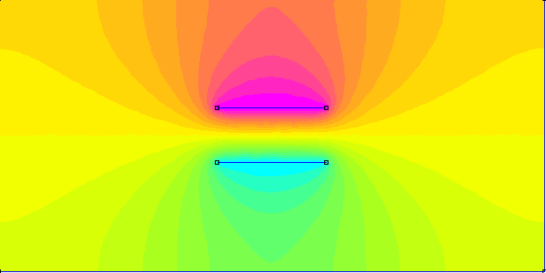
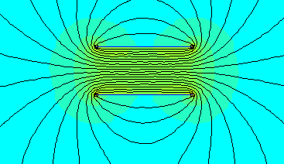
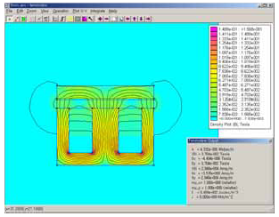
#6, #7 FEMM Simulation (Finite Element Method Magnetics)

Slide 11
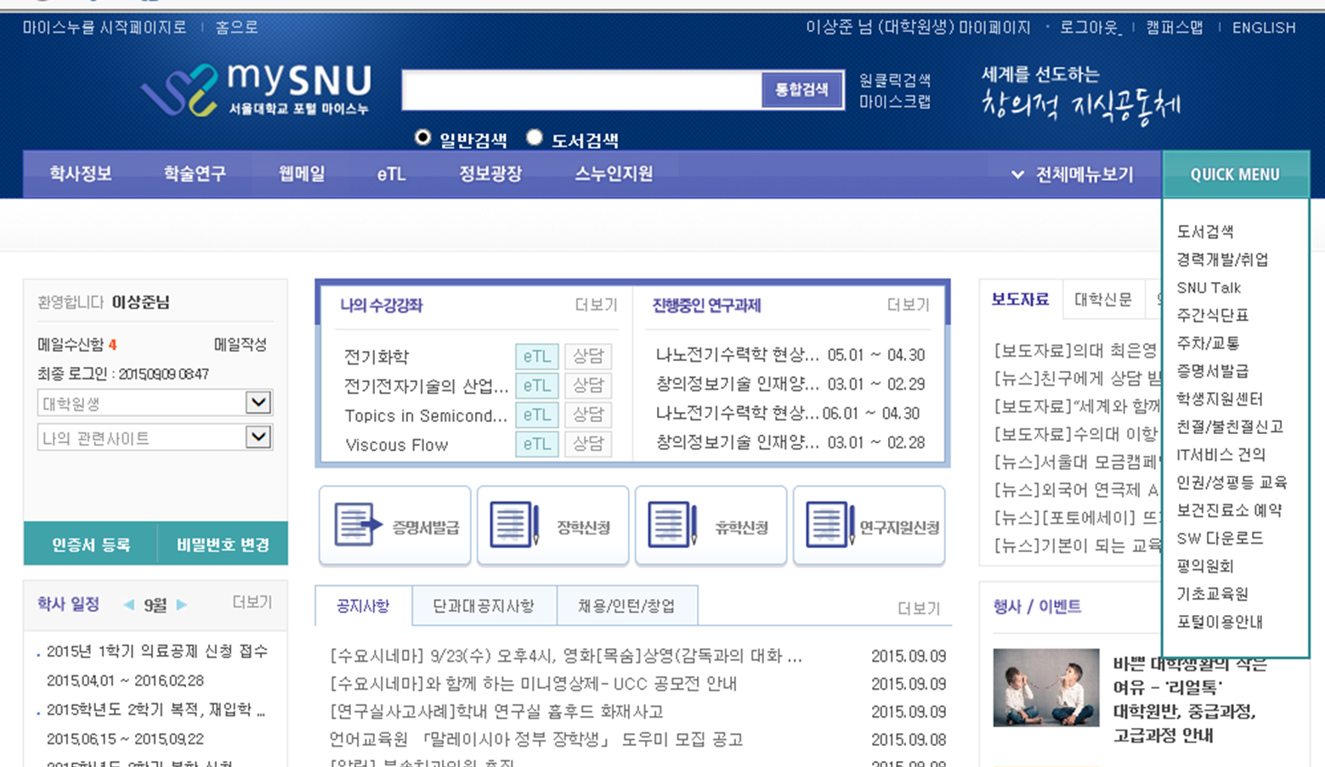
Matlab download

